Slide 1
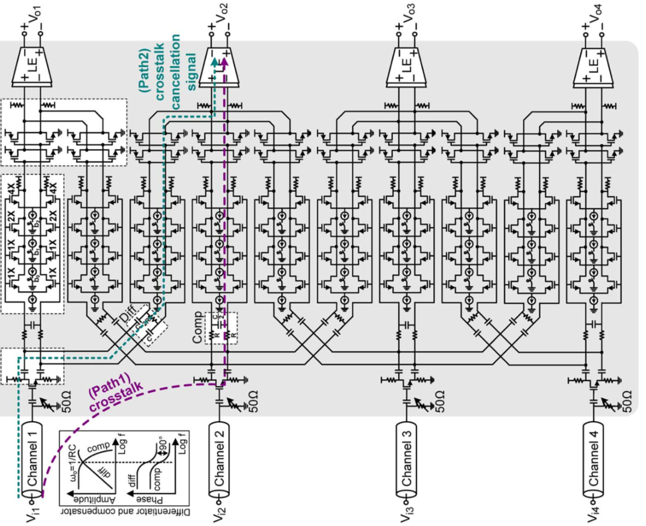
Equalizer Design
Linear
Equalizer
Adder
Variable
Gain Amplifier
Single to
Differential
Converter
[Oh, JSSC 2013]

Slide 2
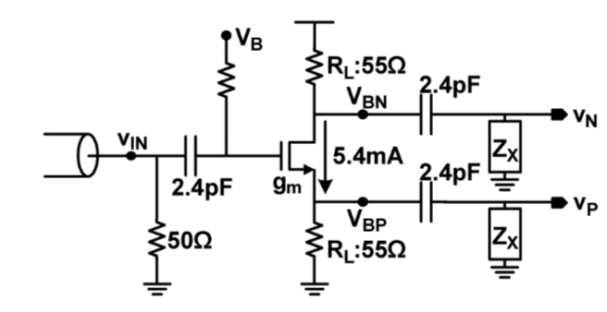
Current design parameters: SDC
Parameters | Value
M:W/L | 50u/100n = 500
R_{L} | 55 ohm
R_{B} | 60k ohm

Slide 3
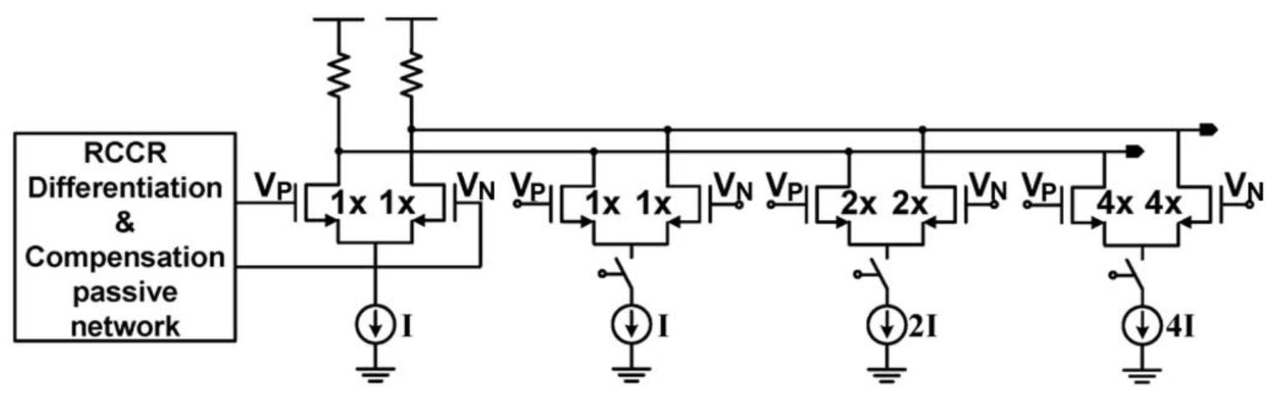
Current design parameters: VGA
Parameters | Value
M_{DP}:W/L | 14, 28, 56
M_{CM}:W/L | 14.5, 29, 58
R_{L} | 1.2k ohm
* All current sources are connected in current mirror configuration. Complete diagram will be uploaded soon.

Slide 4
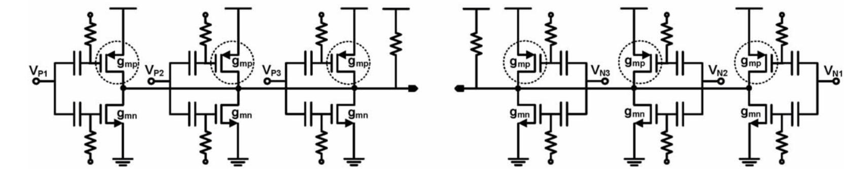
Current design parameters: Adder
Parameters | Value
M_{NMOS}:W/L | 6
M_{PMOS}:W/L | 1.5
R_{L} | 4.5k ohm

Slide 5
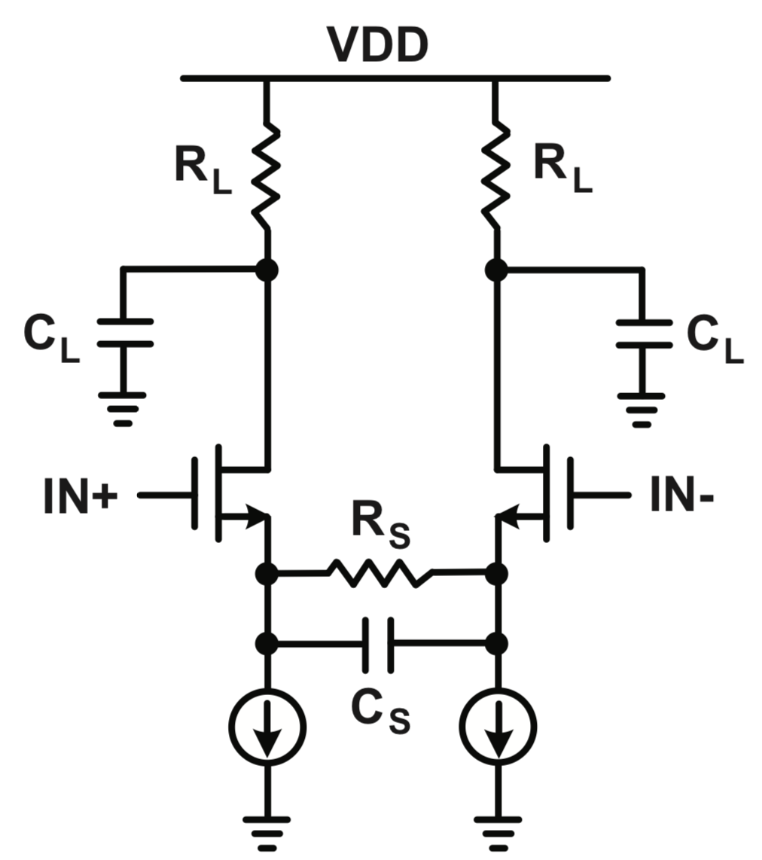
Current design parameters: CTLE
Parameters | Value
M_{DP}:W/L | 17.5
M_{CM}:W/L | 18
R_{L} | 4.5k ohm
R_{S} | 1k ohm
C_{S} | 1.4pf

